Slide 1
CSE322
Formal Languages and Automation Theory
Lecture # 10
School of Computer Science and Engineering

Slide 2
Grammar
Formal grammar is a set of rules. It is used to identify correct or incorrect strings of tokens in a language. The formal grammar is represented as G.
Formal grammar is used to generate all possible strings over the alphabet that is syntactically correct in the language.
G = {V, N, P, S}

Slide 3
Cont…
G = {V, N, P, S}
N describes a finite set of non-terminal symbols.
V describes a finite set of terminal symbols.
P describes a set of production rules.
S is the start symbol.

Slide 4
Example
Suppose we have,
S -> aSb/ε
Then,
We can generate below mentioned strings.
ε, ab, aSb,aabb, aaSbb…..
We can write,
aabb = a^2 b^2
aaabbb = a^3 b^3
Similarly, we will have, a^n b^n(where n>=0)
So language generated by given grammar is : a^n b^n

Slide 5
Cont…
Is abab is part of this grammar?
Can we generate, abab from given grammar S -> aSb / ε ?

Slide 6
Example
If we have,
S-> SS
S-> aSb
S-> bSa
S-> ε
Which language will generate by above grammar?
na (w) = nb (w) (I.e. No. of a = No. of b)

Slide 7

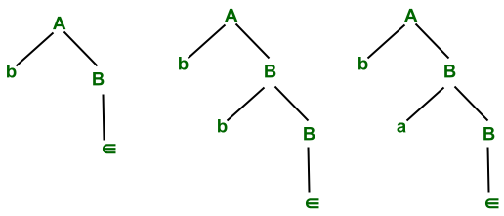
Right linear grammar(RLG):
∑ = {a,b} Initial state(q₀) = A Final state(F) = B
RLG Corresponding to
A ⇢ bB B ⇢ ∈/aB/bB

Slide 8
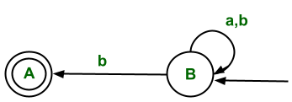
Cont..
The regular language corresponding to RLG is
L= {b, ba, bb, baa, bab ,bba,bbb ..... }
Conversation of RLG to LLG
B ⇢ aB/bB/bA
A ⇢ ∈

